Slide 1


Slide 2
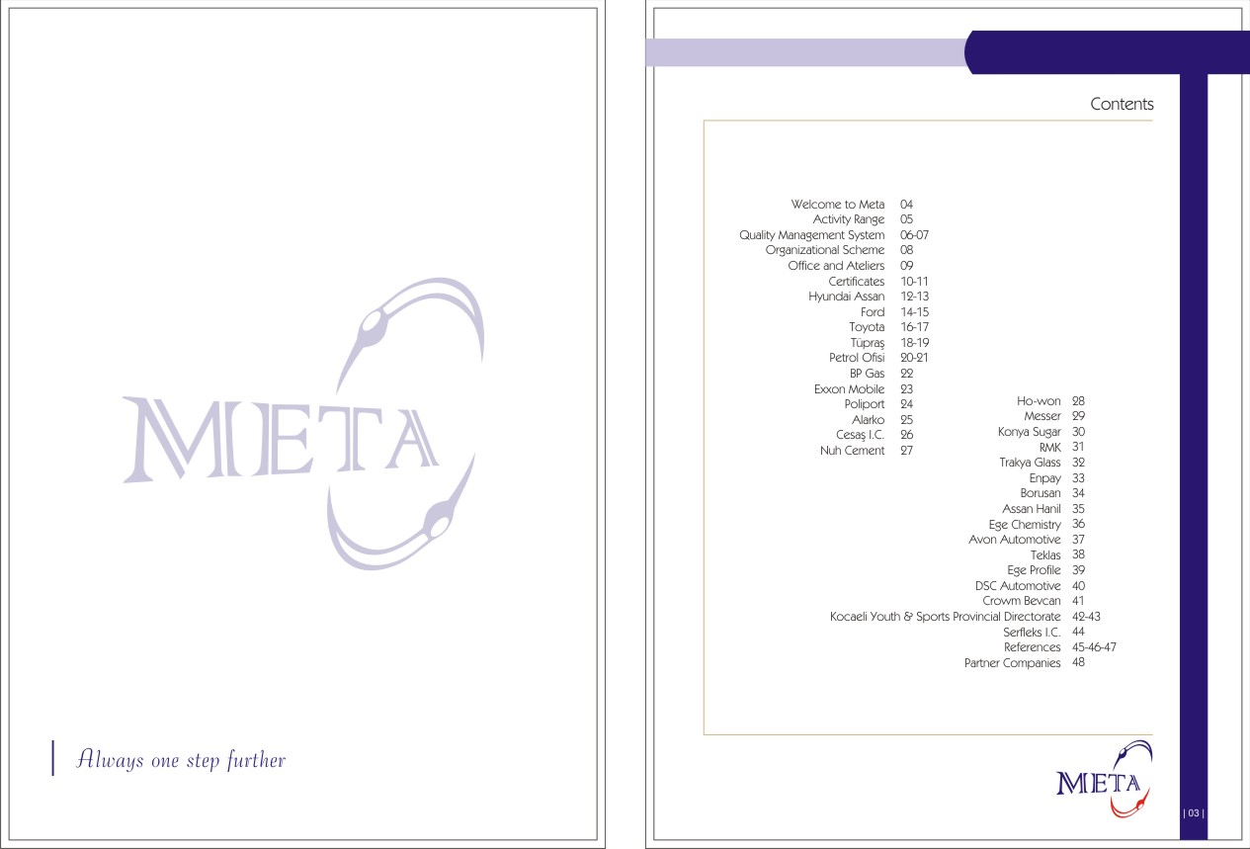

Slide 3
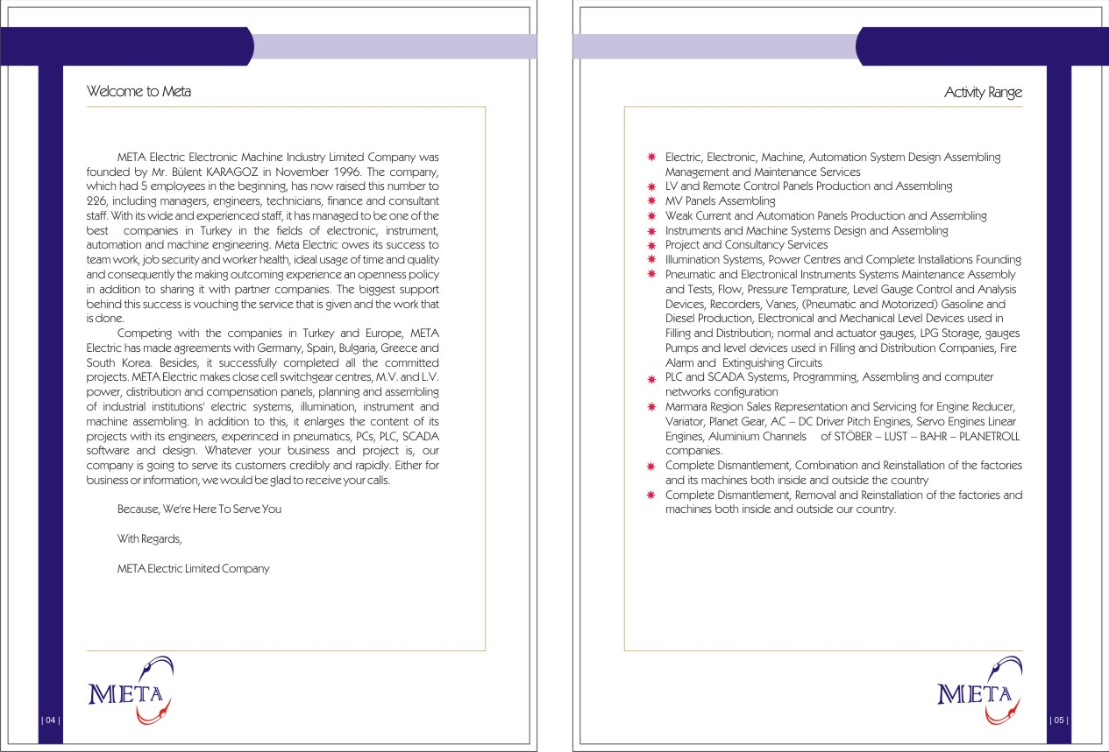

Slide 4
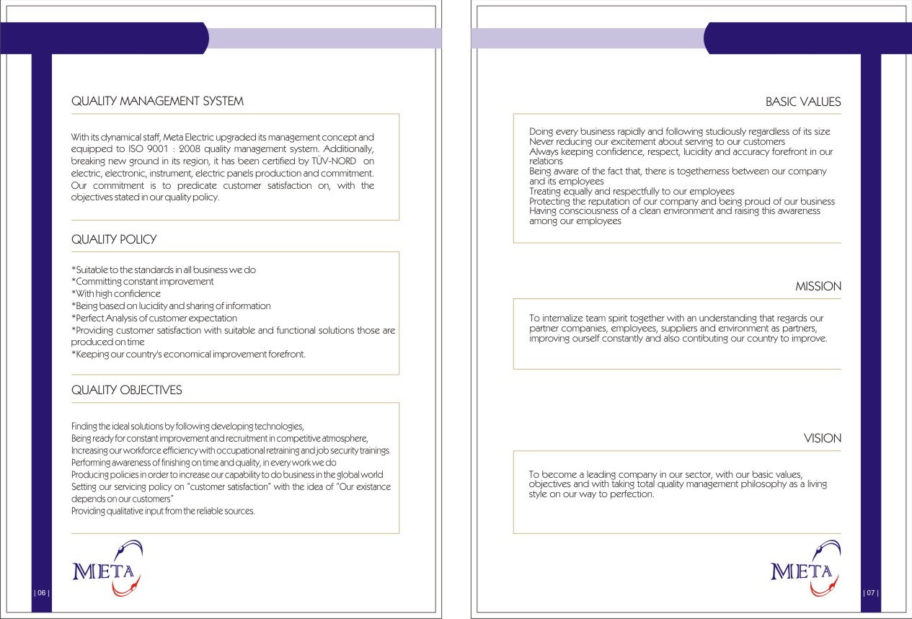

Slide 5
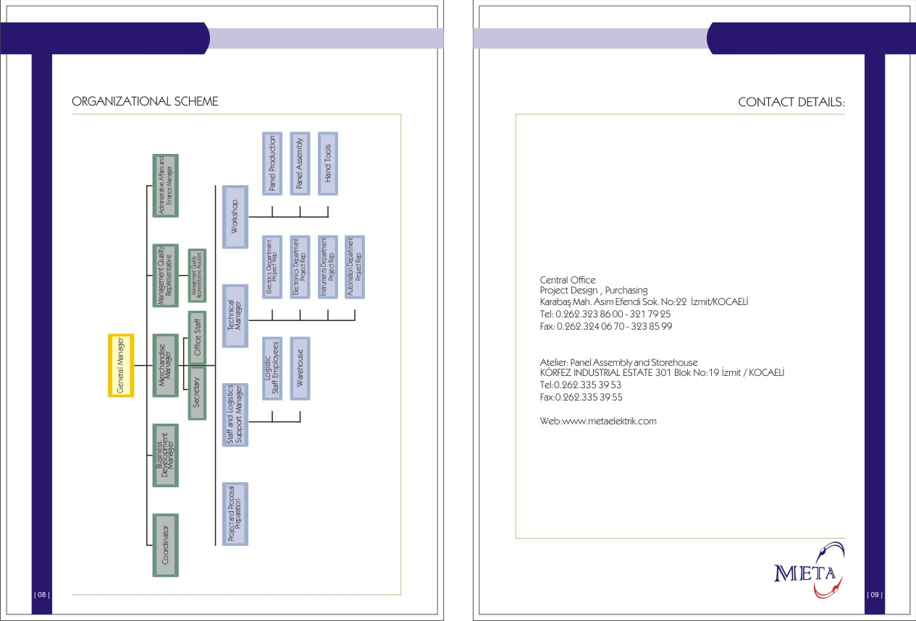

Slide 6
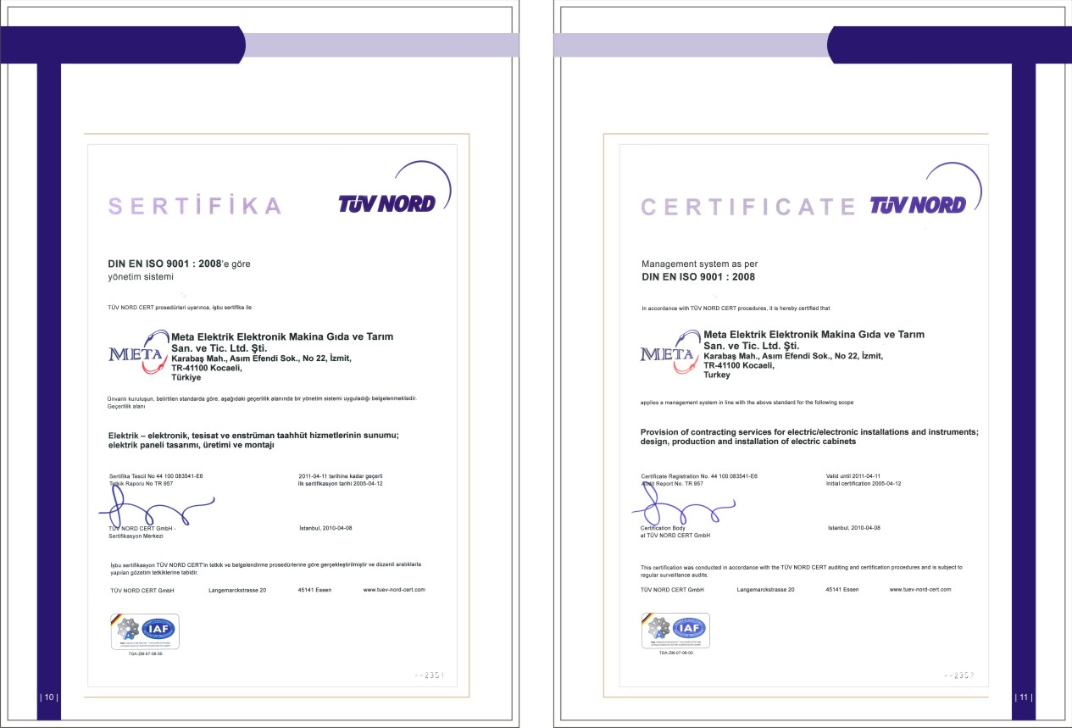

Slide 7
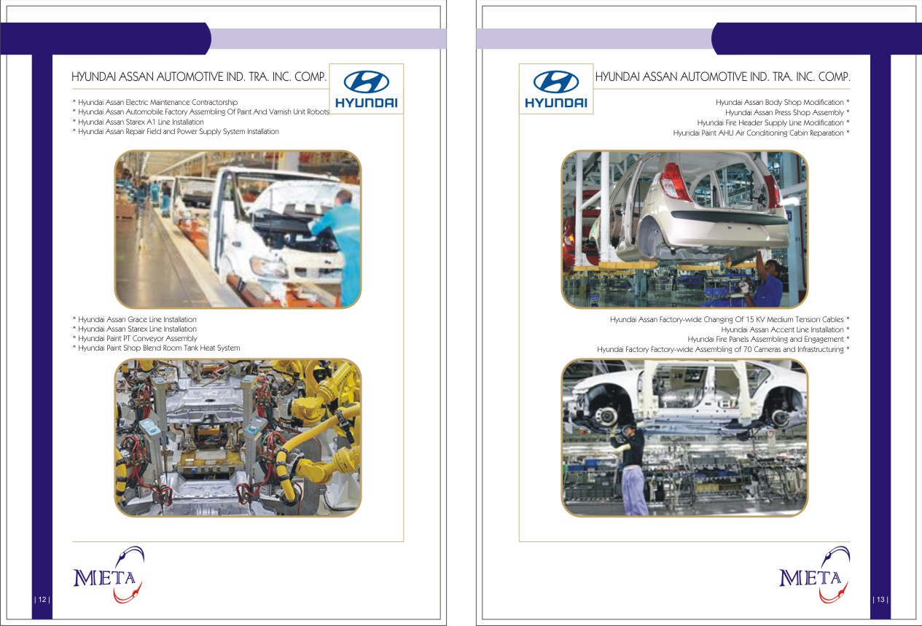

Slide 8
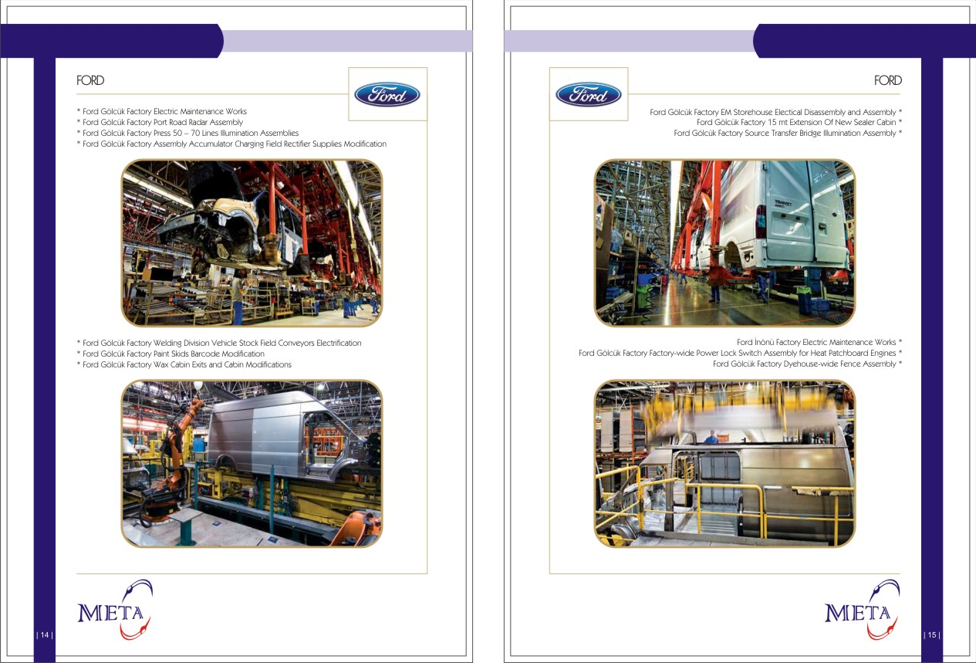

Slide 9
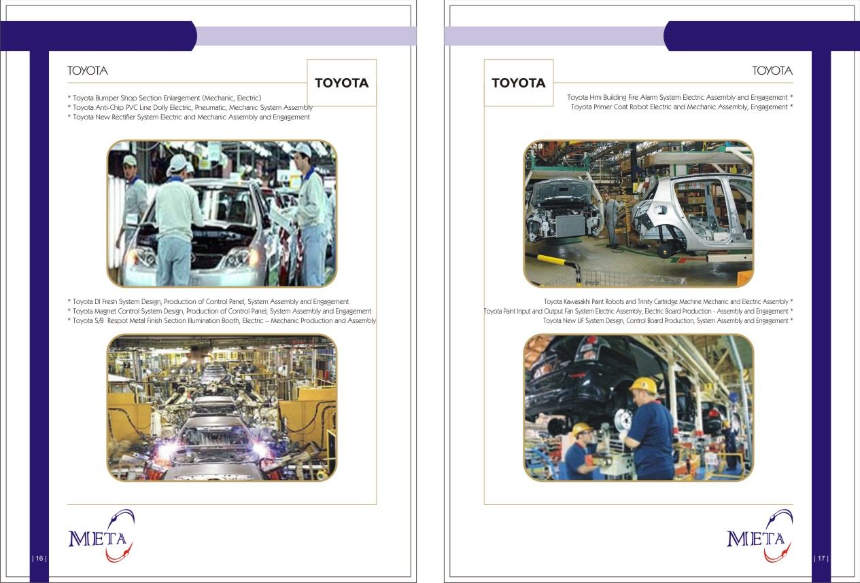

Slide 10
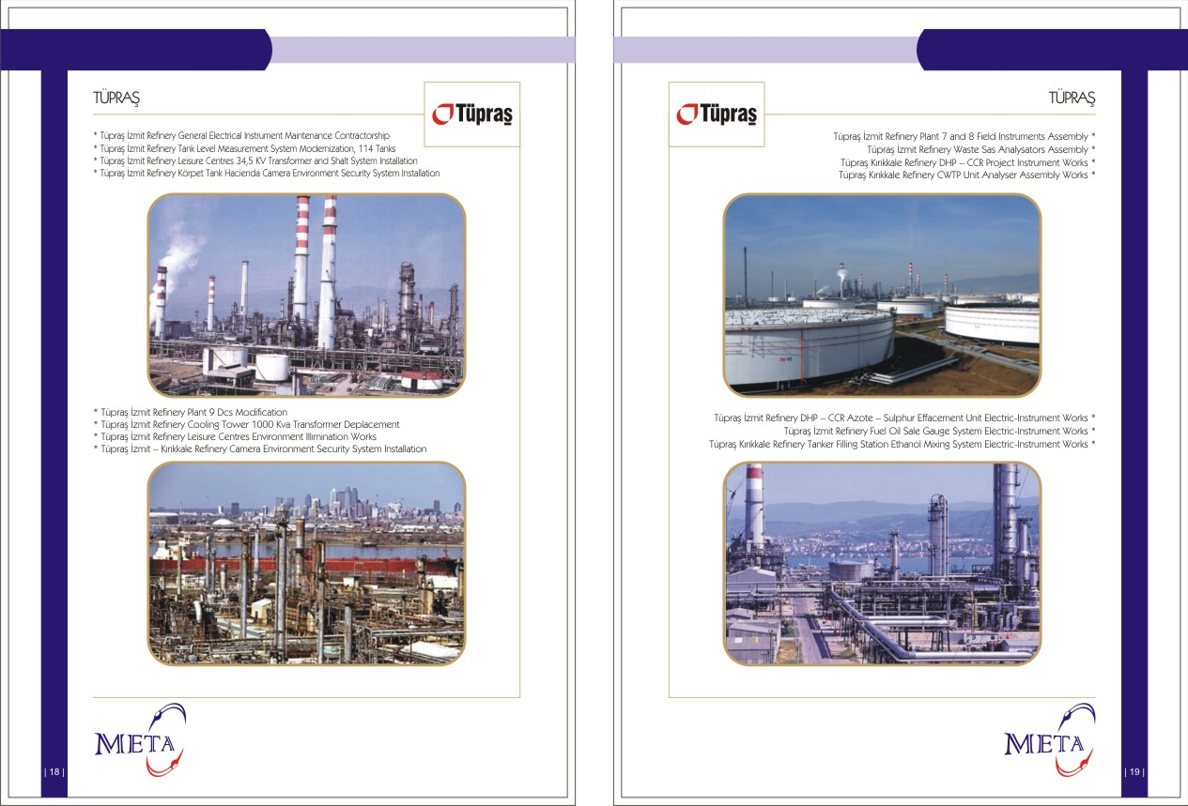

Slide 11
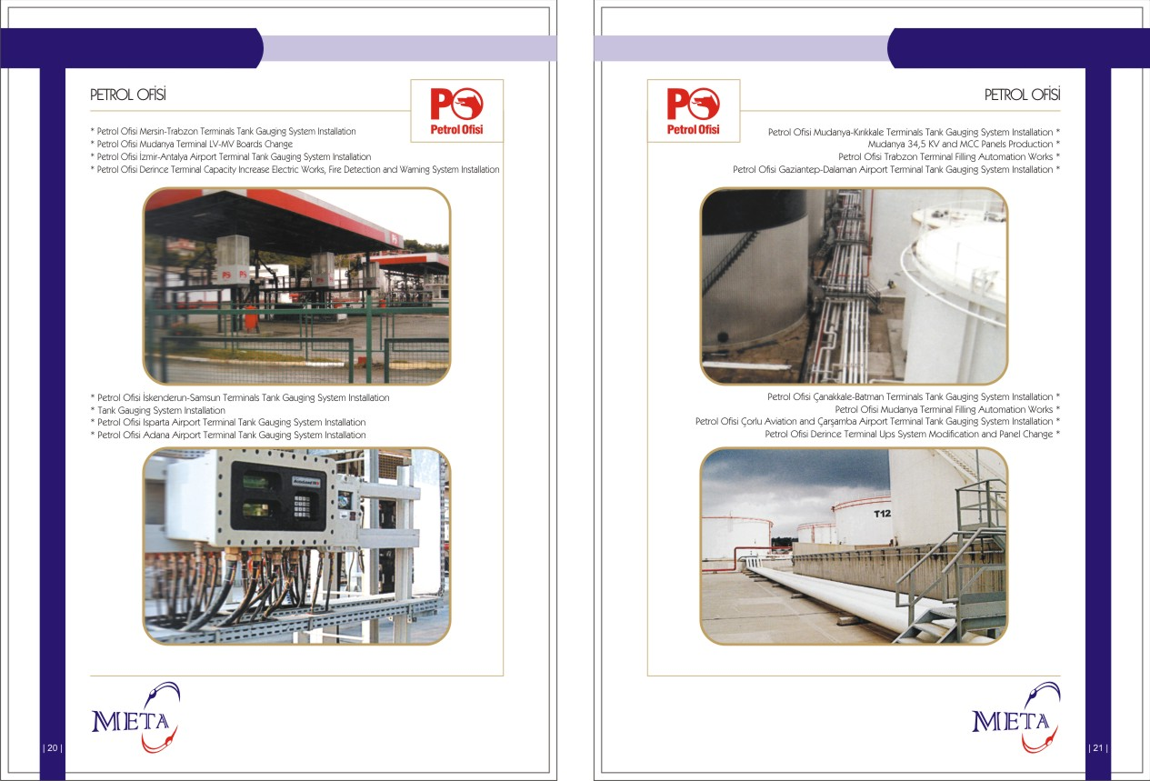

Slide 12
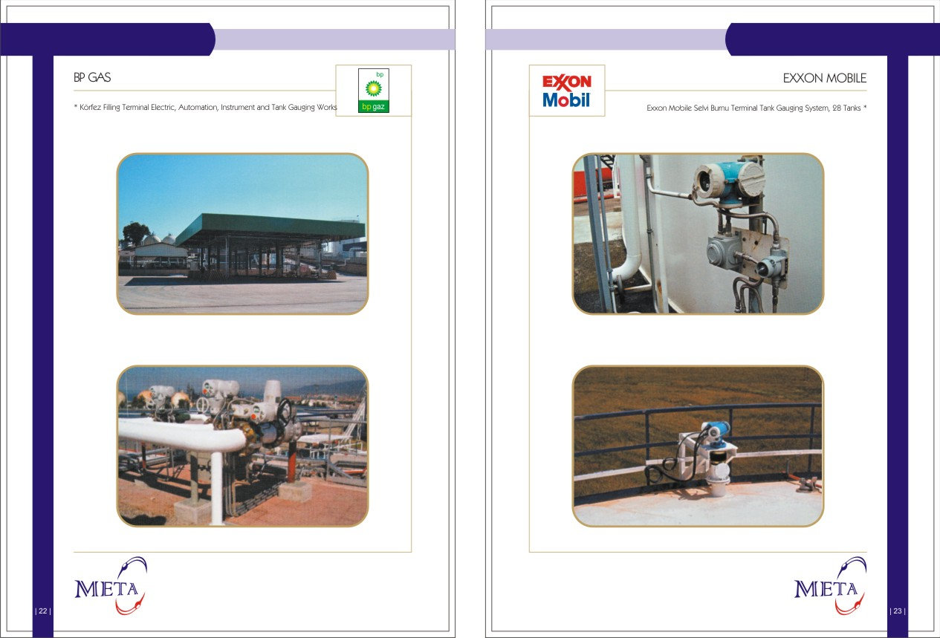

Slide 13
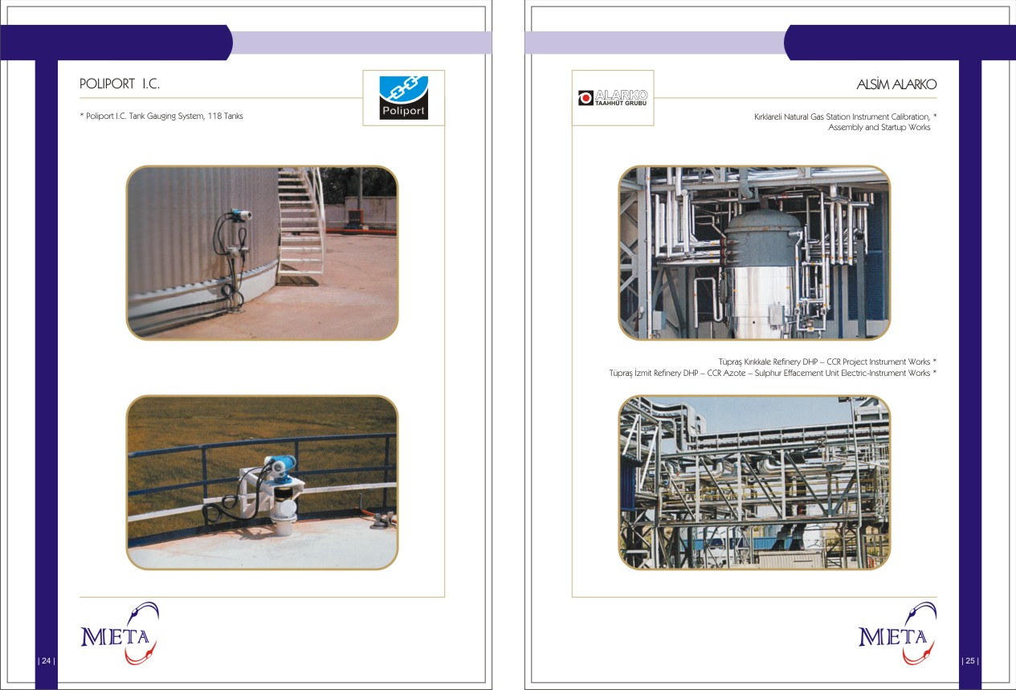

Slide 14
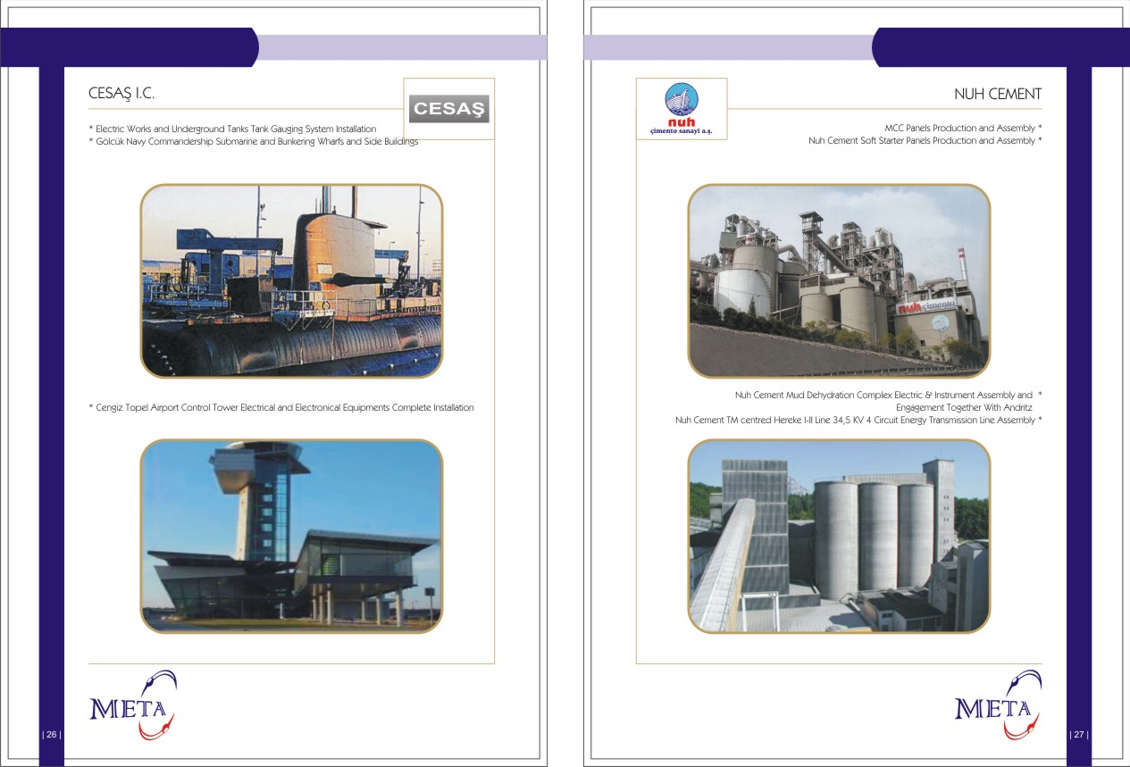

Slide 15
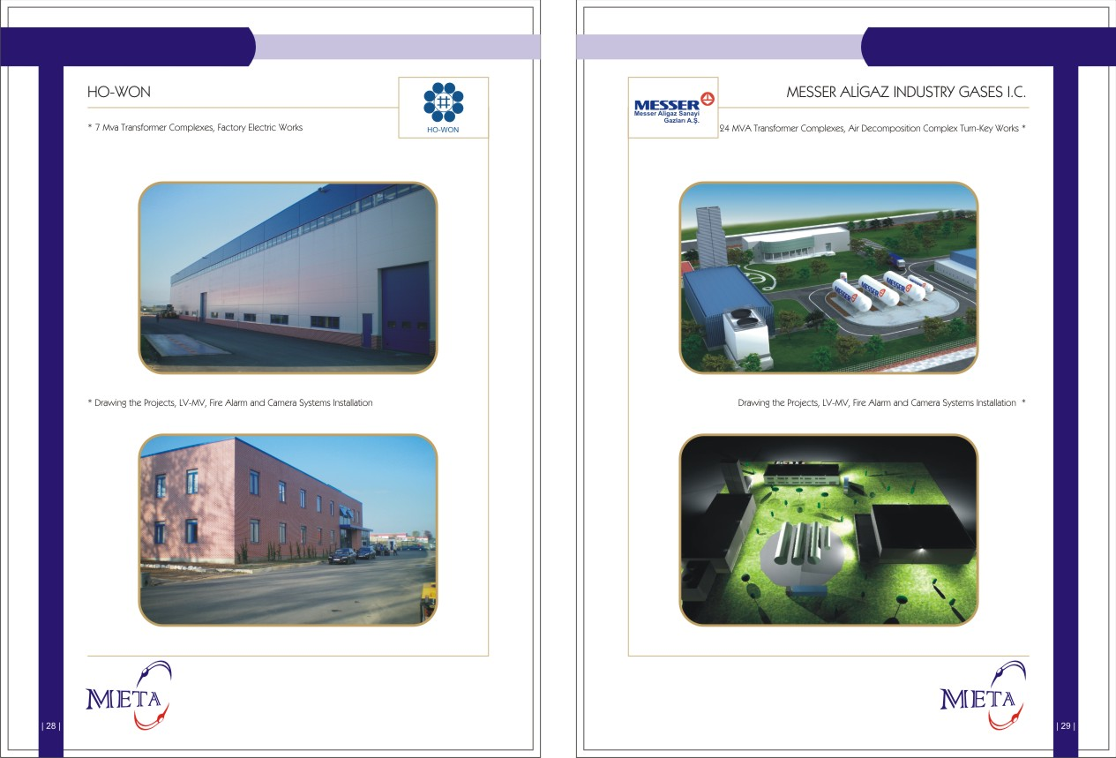

Slide 16
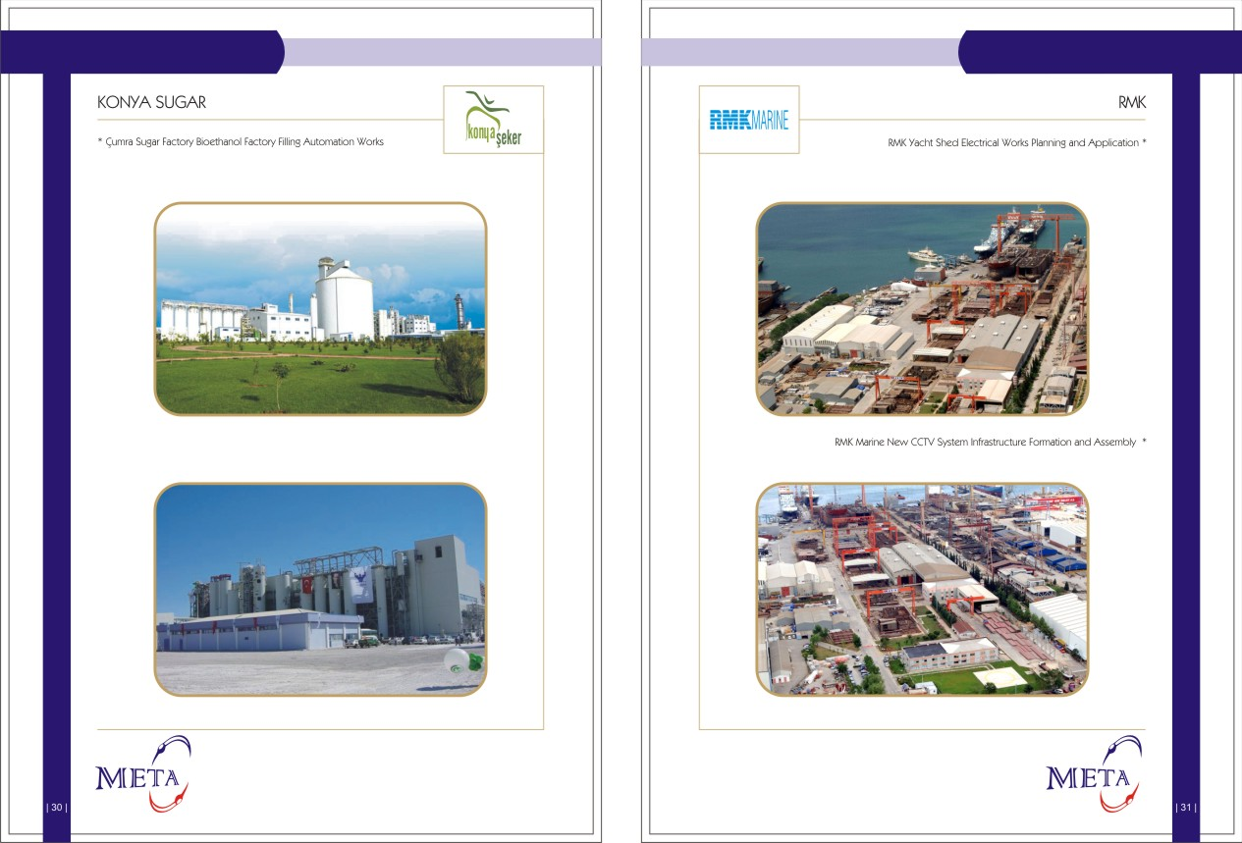

Slide 17
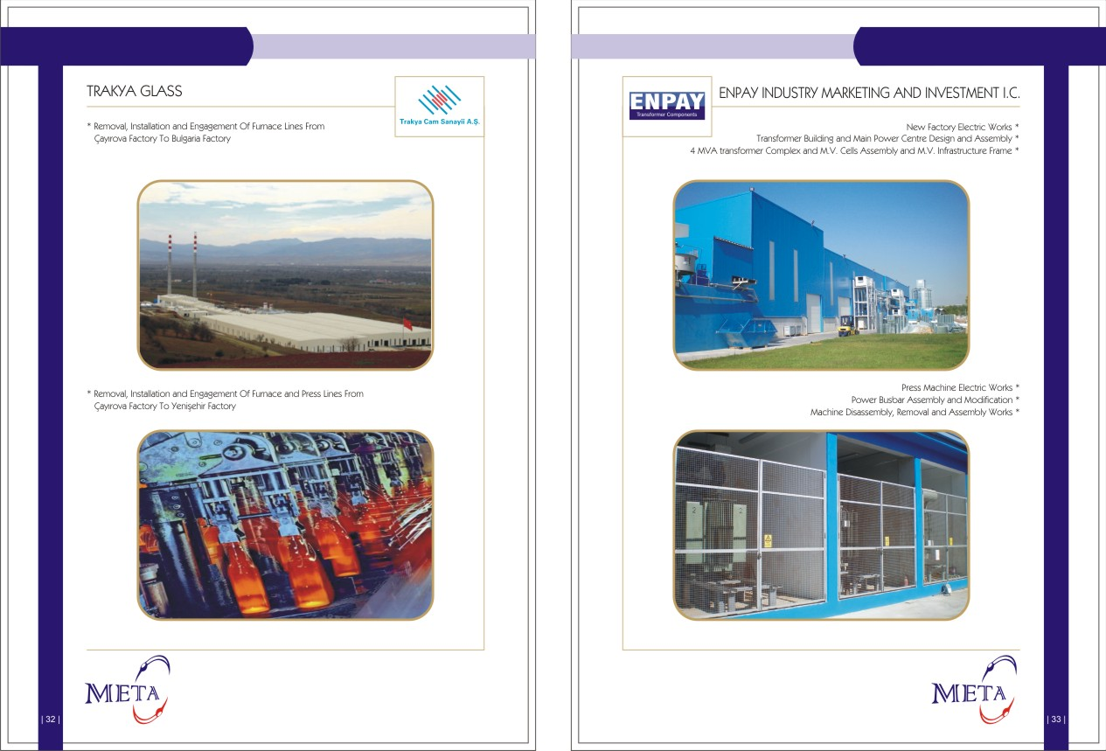

Slide 18
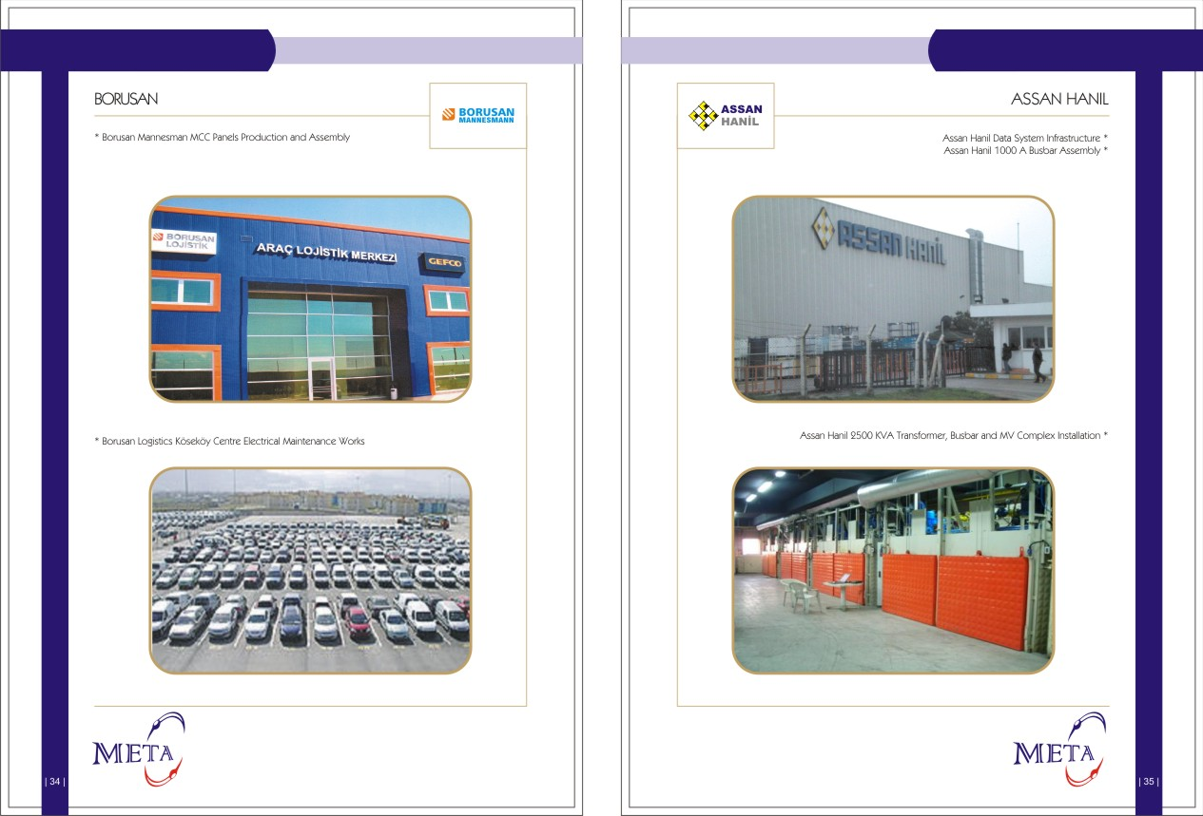

Slide 19
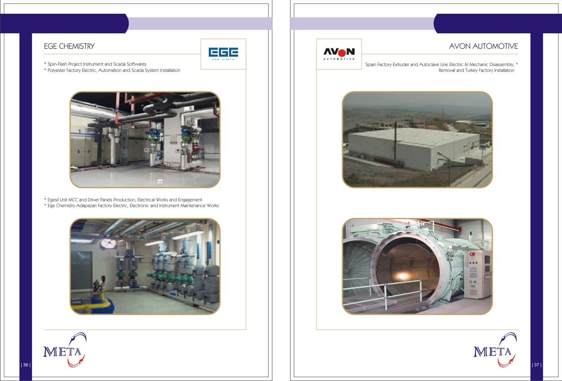

Slide 20
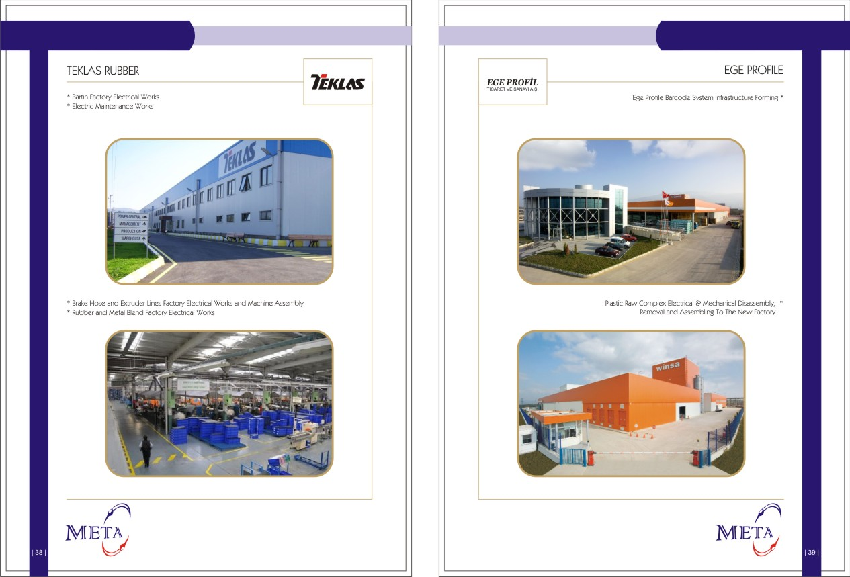

Slide 21
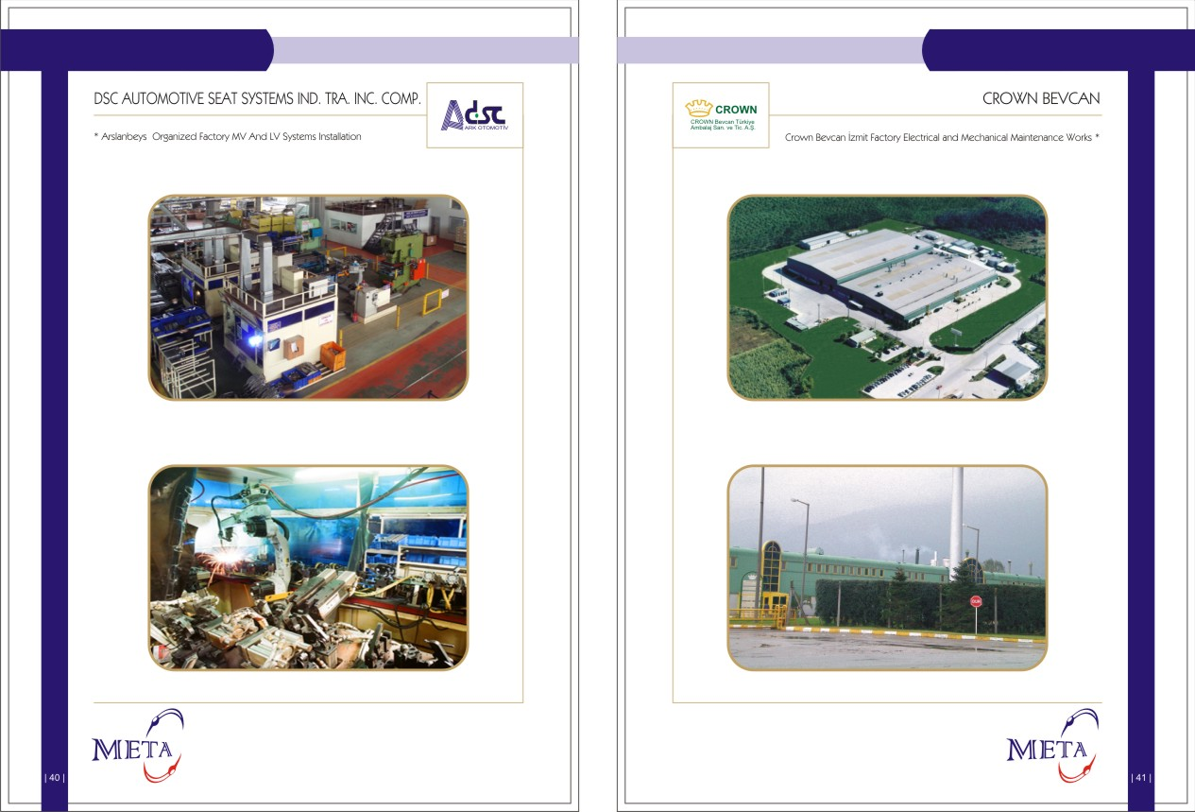

Slide 22
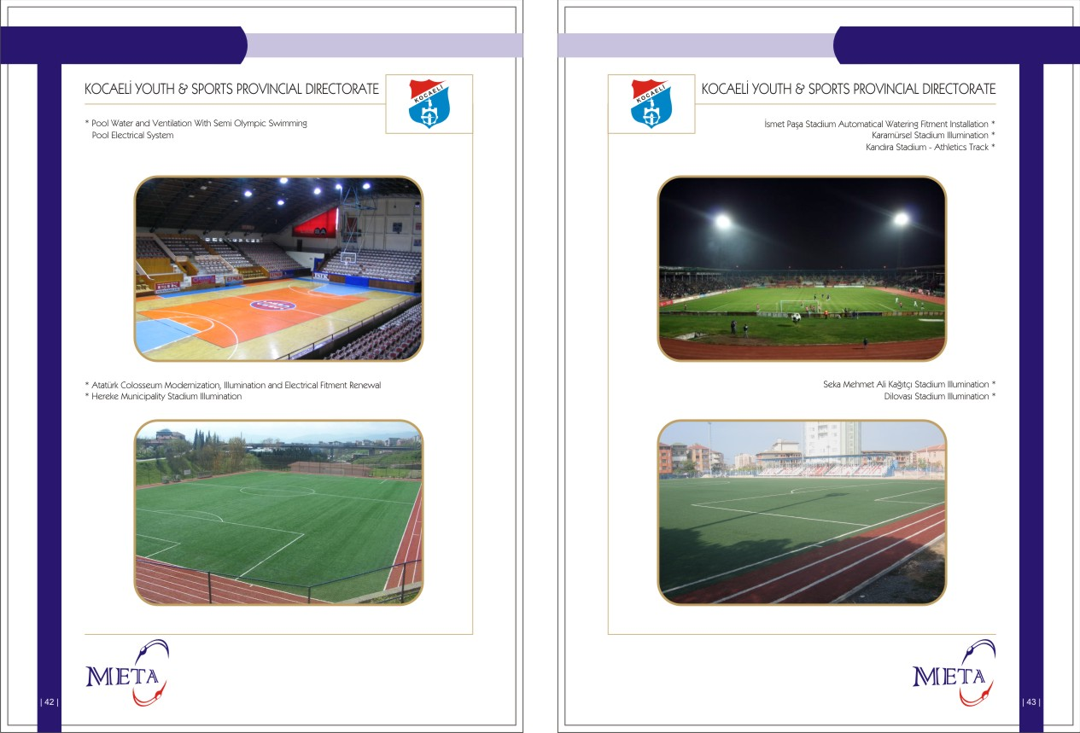

Slide 23
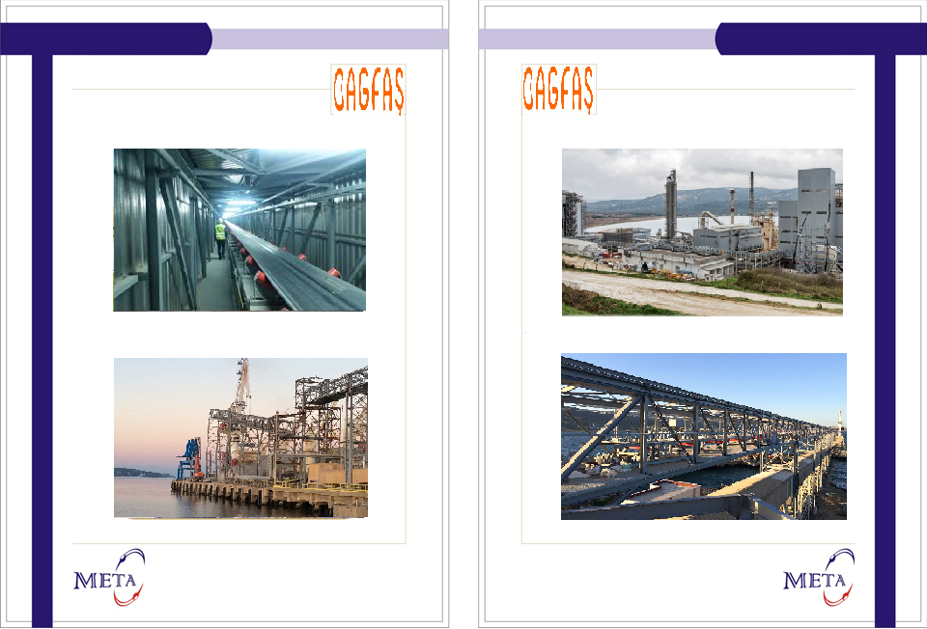
BAGFAŞ/THYSSENKRUPP
BAGFAŞ/THYSSENKRUPP
* Factory Installation
CANAN Tesisleri Electrical-Instrument Works *

Slide 24
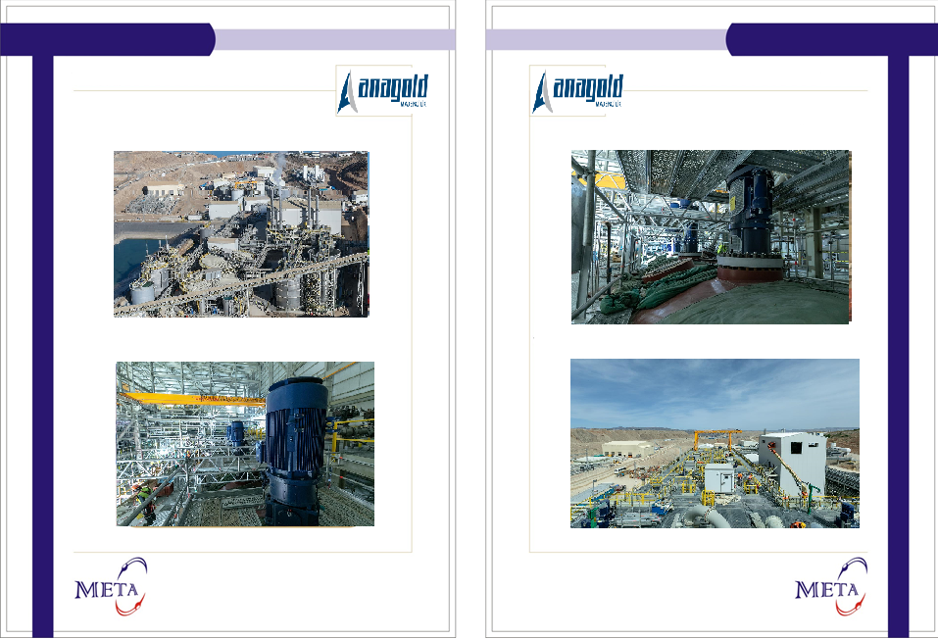
ANAGOLD /ERZURUM İLİÇ
ANAGOLD /ERZURUM İLİÇ
* Electrical Instrument Comissioning and Testing Operations

Slide 25

EXXON MOBİL
EXXON MOBİL
* Electrical-Instrument Works
Tank Gauing System Installation *

Slide 26
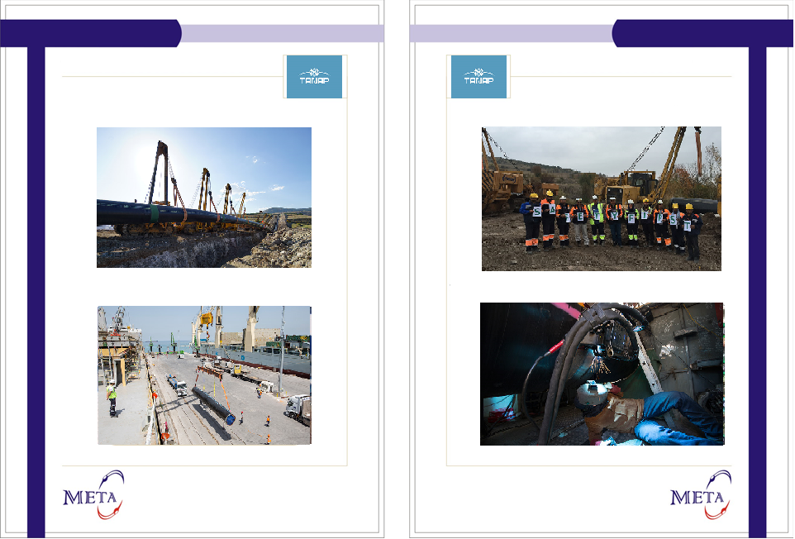
*Valve Stations Electrical and Instrument Works
* LOT2 (Erzincan Erzurum Sivas )
* LOT4 (Eskişehir-İpsala)
Measurement Center, Press Reducer Center *
Pig Throwing and Pig Picking Stations
* Valve Signal Cables Installation
* Hook-up Installation

Slide 27
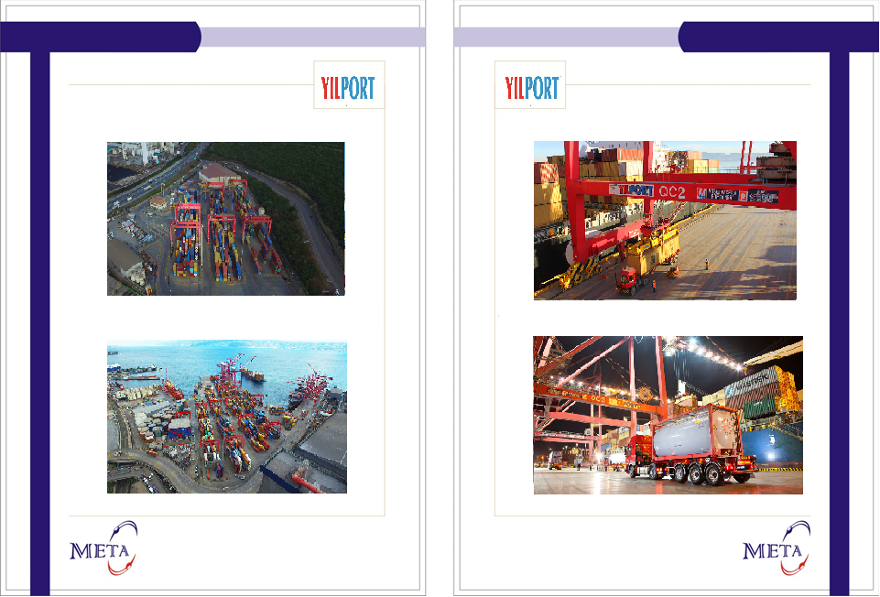
YILPORT
YILPORT
* Electrical Instrument Works
Tank Gauing System Installation *

Slide 28
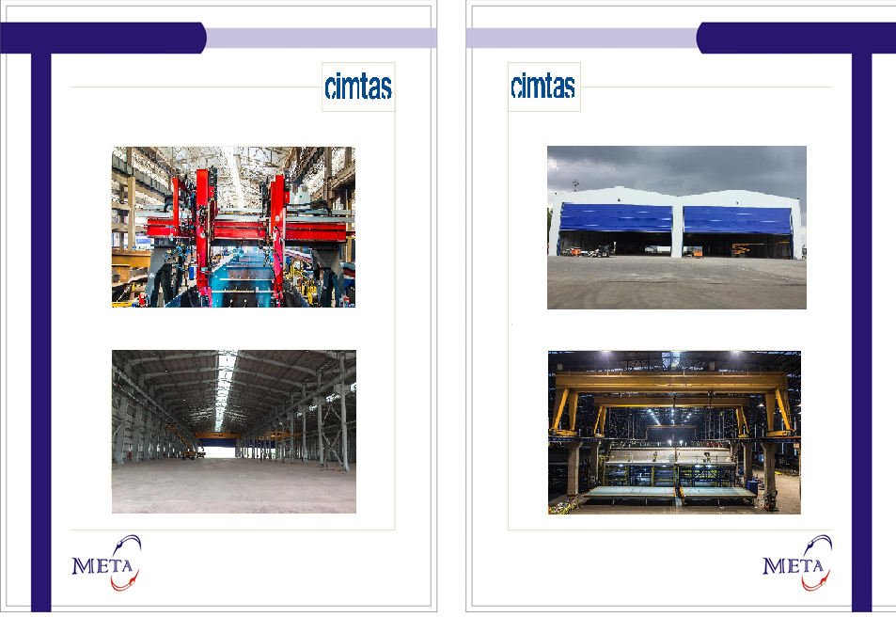
CIMTAS
CIMTAS
* Medium Voltage and Low Voltage Project
* ÇİMTAŞ SHİPYARD Production halls 4 and 5
* All Electrical Design and Manufacturing
128 Pieces Armature Assembly*
450 Metre Busbar Assembly*
* 27 Units of Combined Socket Panels Manufacturing and Assembly
4 Pieces of 63 Ton Crane Powering *

Slide 29
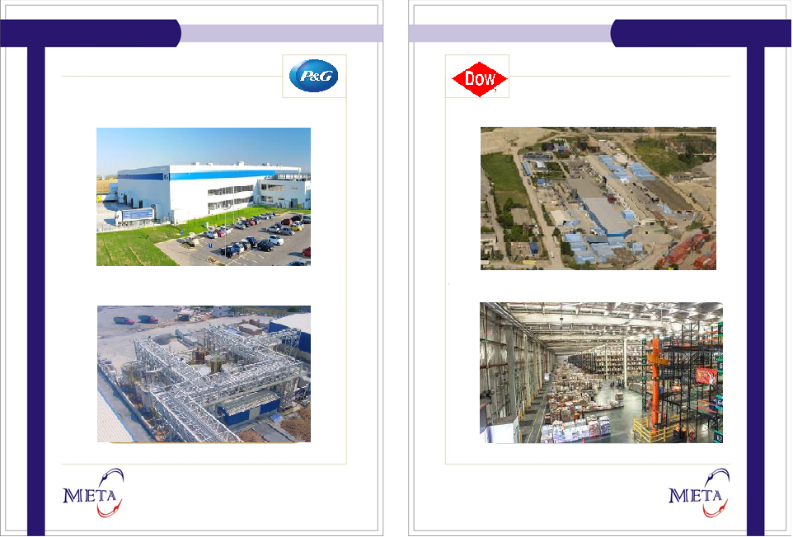
PROCTER GAMBLE
DOW
* Fairy Line renovation
Transformer and Distribution Center Installation *
Medium Voltage and Low Voltage Panels Production *
installation of Medium and Low Voltage Panels *

Slide 30
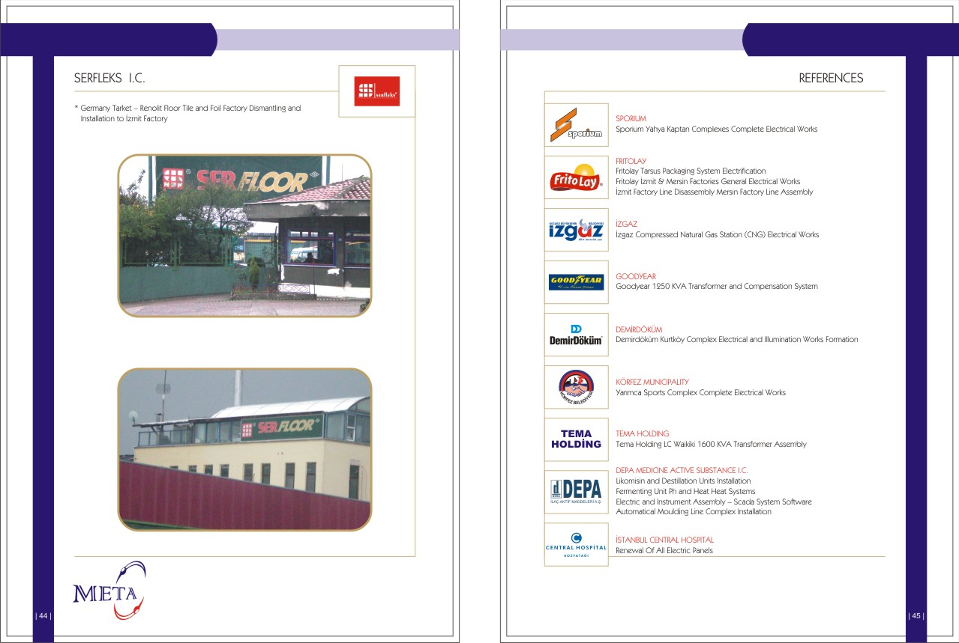

Slide 31
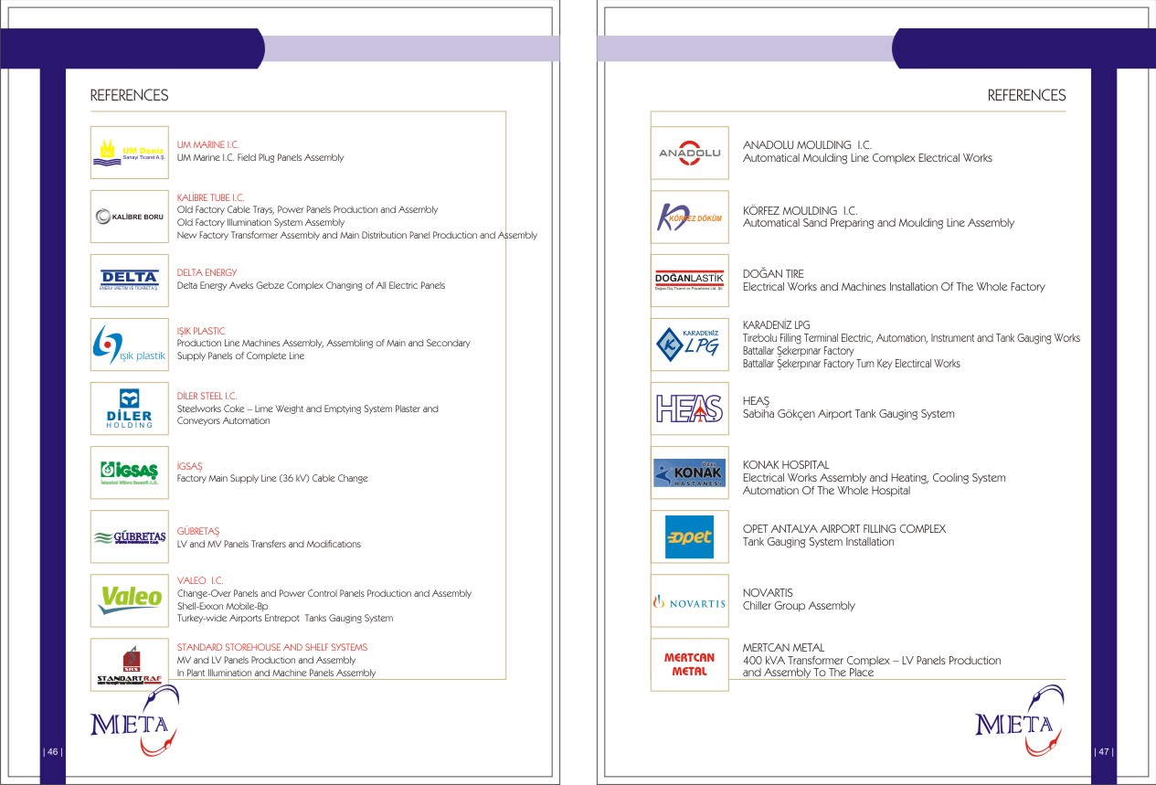

Slide 32
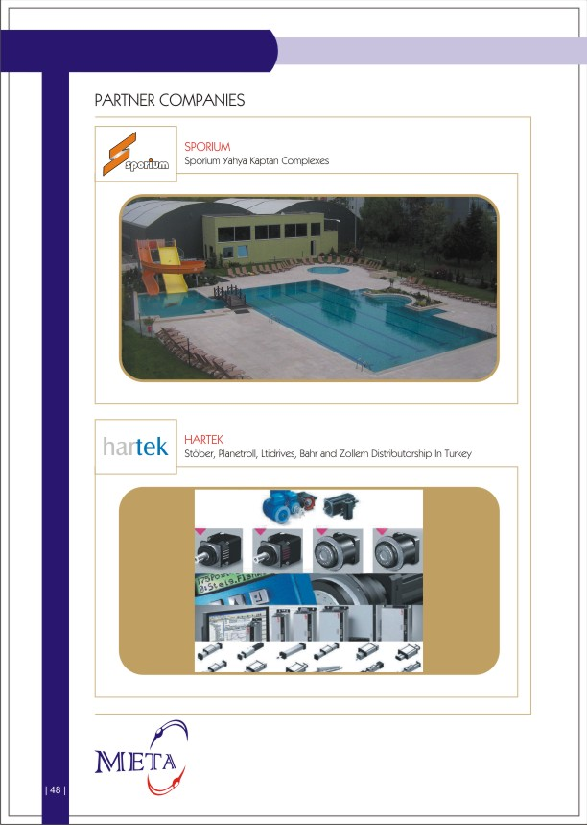

Slide 33
